Slide 1


Can’t Say: “Yes or No”:
This is how you do it.
Pair work/group work/T-SS
One student asks the other questions to try to get them to say, “Yes or No”.
The other student must answer the questions, but without saying “Yes or No”. It’s a fun activity that requires students to think on their feet.

Slide 2
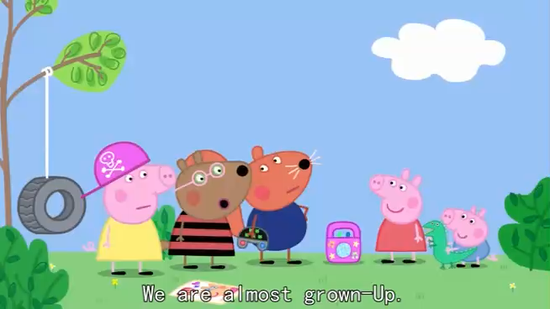
Where did I get my inspiration from?

Slide 3

贵阳市英语学科带头人工作站“激励教学”2022年教师培训工作坊
Session 7
Getting teenagers to talk
Dr Helen Hou
Ulster University & QNUN
08/12/2022

Slide 4

We are going to
Identify factors that stop teenagers taking an active part in speaking
Reflect & analyse
Share your takeaway
Learn how to plan effective activities that will motivate them to participate
Collaborative listening (talk you through if we have time)

Slide 5

Online Class Rules
Your active participation is key to a successful webinar !
Be here and now
Jot down some ideas that might be useful
Think, analyse, reflect, question & share
Enjoy it if you can

Slide 6

Remember to have:
Your pen(s), notebook and earphones
Some water & snacks
A good mood

Slide 7

You’ve spent a good few hours designing a lesson…
Carefully planned with a lot of interesting activities (well, at least you think so…)
It’s a demo lesson that you really rely on to impress your colleagues or headmaster
You have imagined how well-received it will be, but somehow it just doesn’t work…
You start to wonder why…

Slide 8
Getting teenagers to talk
Have you ever asked yourself the following questions about your ss?
  Why are they so timid/shy?
  Why do they look bored and uninterested a lot of the times?
  Why won’t they volunteer answers during class discussion?
  Why won’t they share ideas when asked?
  Why won’t they interact in pairs as expected?
  Am I putting too much pressure on them?
  Is it because of me? Do they just dislike me?
  How can I stop them speaking together in Chinese?
  Should I always stop them speaking in Chinese?
Adapted from Pete (2015)

Slide 9
Go to www.Menti.com and enter code 67697926
What are the challenges when teaching speaking to secondary learners?
https://www.mentimeter.com/app/presentation/alfgets1d61ddyinu4kpecgg8ig788gc/c4o2x1vuusw2

Slide 10

Some teachers’ reflection

Slide 11
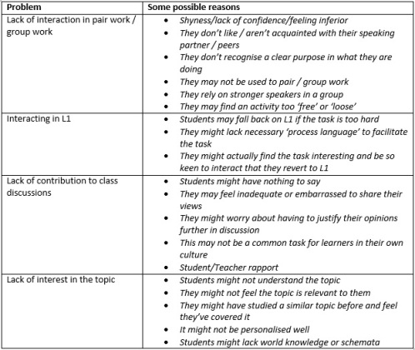
Pete 2015

Slide 12

So, how can we overcome these challenges?

Slide 13
Reflection may help with solutions
Do I make students feel more nervous by nominating them? Can I change my nomination techniques to limit this?
Are my instructions clear?
Have I learnt enough about the students?
Have the class always been quiet? How is their rapport in other classes with other teachers?
Are my learners familiar with communicative tasks and my expectations?
Am I scaffolding tasks effectively?
Am I providing process language when it’s needed?
Do students understand what they are achieving in each task?
Are tasks too difficult/too esay?
Am I personalising the lesson topic effectively?

Slide 14
Tips for Getting Teenagers Talking
Explain why it’s important (purpose)
Building confidence (differentiation, scaffolding, achievable LOs
Ground rules (set goals together)
Giving students preparation time before speaking/ Preview tasks
Can they connect the topic to their lives?
Consider when to ‘spotlight’ students individually (Vary nomination methods, allow ‘pass’)
Use agreed rewards & ‘penalties’
use clear instructions (an example, use S as my assistant, write them down)

Slide 15

Planning a Lesson that encourages teens to talk
Clear skill focus (better one at a time)
Authenticity (real purpose, transferrable)
Fluency
Accuracy
Appropriateness (Pragmatics)
Differentiation (top, middle and bottom)
Assessment and Feedback (Feedforward)

Slide 16
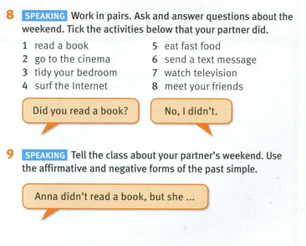
Bringing the Coursebook to Life
Think how you can use task 8 and 9
in your classroom creatively?
Try to make your tasks more interactive
allow students to move…
(from Solutions Elementary lesson 7D)

Slide 17

Bingo!
1. Create a bingo sheet with all the same prompts (consider differentiate the prompts) explain why and when (small talk-social, relationship, caring…)
2. Ss each has a bingo sheet, and they need to ask those questions to different classmates to collect yes/no answers (a different person for each box)
3. (set a time ) S who collects the most yeses shouts bingo, and the task ends. The winner gets a reward.
4. Ss prepare to report back to class (like a survey, allow “pass” or Ss nomination)
5. Ter gives feedback and recap the purpose
6. Let students design their own bingo sheet

Slide 18
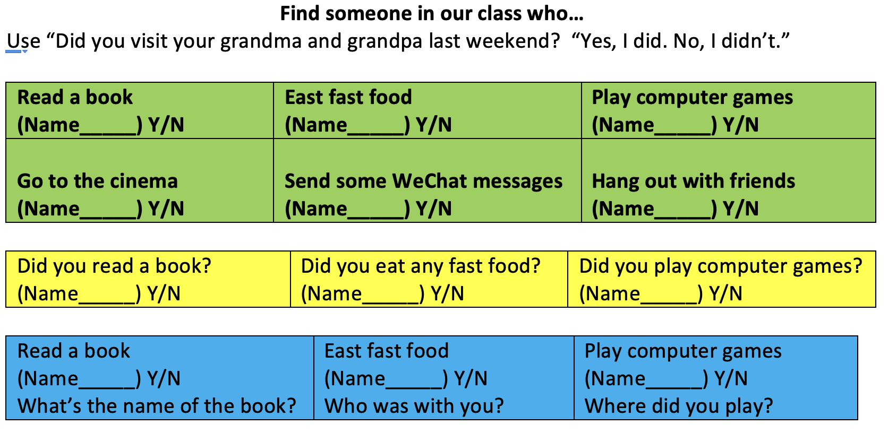
Bingo

Slide 19
Tips for Getting Teenagers Talking
Explain why it’s important (purpose)
Building confidence (differentiation, scaffolding, achievable LOs
Ground rules (set goals together)
Giving students preparation time before speaking/ Preview tasks
Can they connect the topic to their lives?
Consider when to ‘spotlight’ students individually (Vary nomination methods, allow ‘pass’)
Use agreed rewards & ‘penalties’
use clear instructions (an example, use S as my assistant, write them down)

Slide 20
Bingo! What other language points can we practice with Bingo?
Can you… bingo
Do you… bingo? Are you… bingo
Have you ever… bingo? (PP)
Are you going to… in the summer?
Will you… ?
Had you… when you were a little kid?
If you had a magic wand, would you…
If you were a boy/girl…
A mixture of all tenses as a consolidation exercise

Slide 21
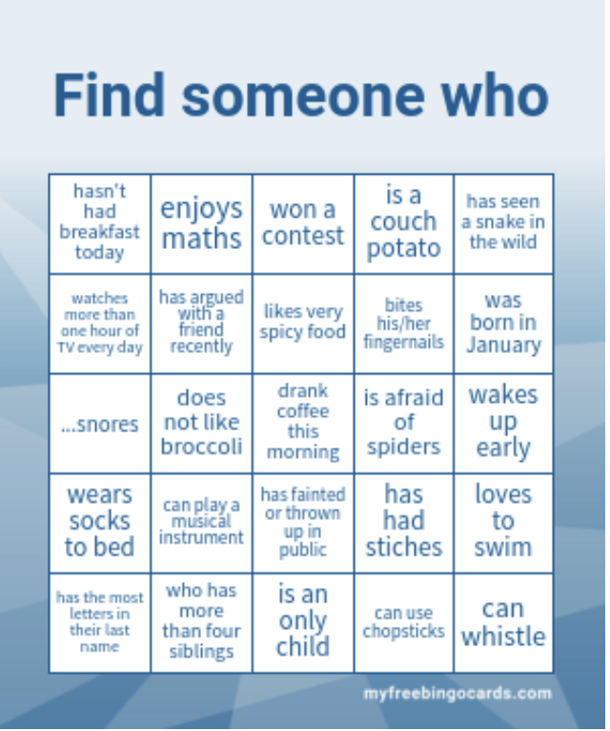
Semi-free resource
https://myfreebingocards.com
/human-bingo/find-someone-who/edit

Slide 22
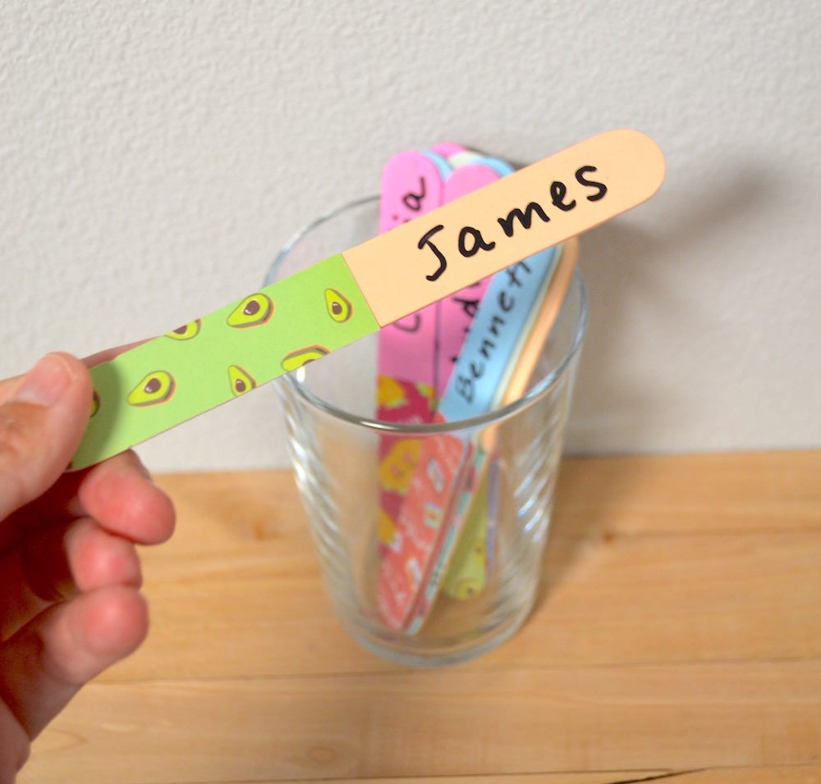
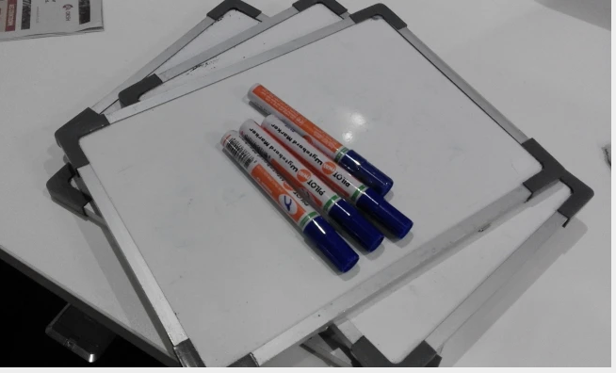
Some other techniques
Use a lollipop method to nominate
Use mini-white board (Yeah!)
Set clear roles for group task ( Helen will chair the discussion and make sure everyone contribute, can Rebeca take notes, after 5 mins, I will ask Jack, Collin, Maeve in G1 to report back)
Teach and showcase how to use ‘target language’ (expressing different opinions: agreeing, disagreeing )
1
2

Slide 23

Your exit ticket
Overall feeling about this session
2-3 things that you think you will take away
1-2 things that you think you can do with your students
1 question that you still have

Slide 24
References
https://myfreebingocards.com/human-bingo/find-someone-who/edit
https://eltplanning.com/2015/10/21/getting-teens-to-talk/

Slide 25
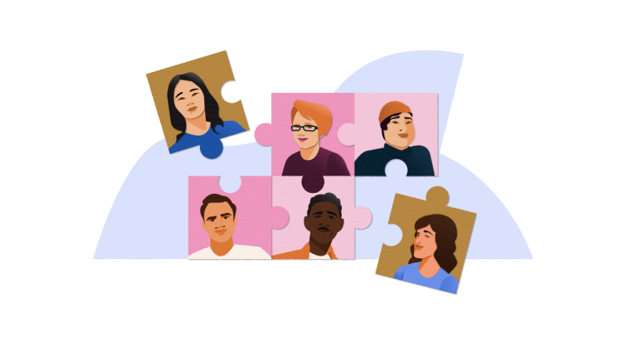
Collaborative listening
3-5 students in a group (can be from 3 to 7 students in a group)
1 S, acting as a tech person, is in charge of playing the recording (stop, rewind, fast forward, play again…). Only the tech person can control the recording.
一名学生扮演技术人员，负责播放录音（停止、倒带、快进、重放······），只有技术人员才能控制录音。
Two or three Ss are responsible for listening to the recording and feeding the scribe whatever they’ve heard.
两个或三个学生负责听录音，并向抄写员提供他们听到的内容。
1 S is in charge of writing down what they have been told by their peers.
一名学生负责写下同伴告诉他/她的内容。
20 minutes

Slide 26
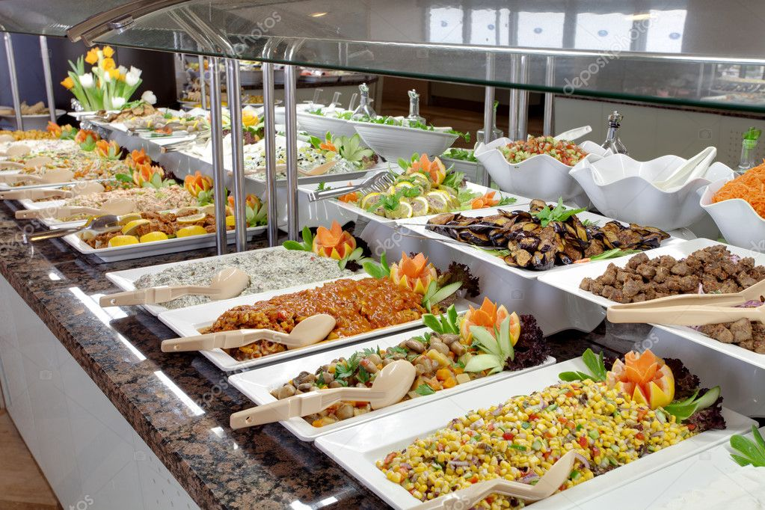
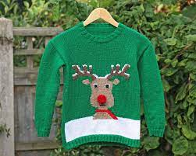
Collaborative listening Prep
Some words that you may not know:
buffet
jumper

Slide 27
Transcript
Mark: I don't think you're an idiot at all. I mean, there are elements of the ridiculous about you. Your mother's pretty interesting. And you really are an appallingly bad public speaker. And you tend to let whatever's in your head come out of your mouth without much consideration of the consequences. I realise that when I met you at the turkey curry buffet that I was unforgivably rude and wearing a reindeer jumper that my mother had given me the day before. But the thing is, um, what I'm trying to say very inarticulately is that, um...In fact...perhaps, despite appearances...I like you-- very much.

Slide 28
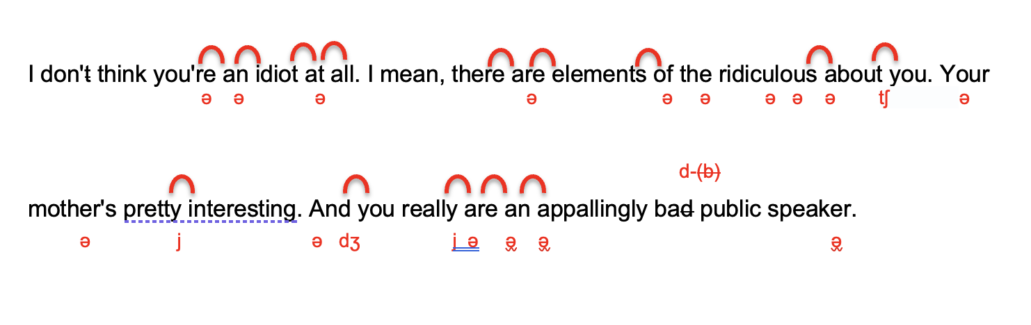
Put a spin on listening: pronunciation

Slide 29
Collaborative listening: reappraising pre-while and post listening model
Intensive, mindful listening focusing on both meaning and form
Choice and voice
(student agency)
Teamwork and persistence
(lowered FLLA and more enjoyment)
All inclusive approach

Slide 30
Listening materials (criteria & sources)
Less than 1.5 minutes long
A wide rang of topics, types, formal/informal (think about the list of activities, as well as features of spoken English)
Socially, culturally and age-wise suitable to our students
Movie extracts, children’s cartoons (Peppa Pig ), TED talk, podcasts, BBC one-minute international news, BBC/VOA news, audio-books, apps such as Otter

Slide 31
Thank you for taking part!
See you next Thursday!

