Slide 1
Scavenger hunt: find us an object (寻宝游戏)
Turn your camera on and allow us to see your face just for this activity ☺
Be careful when you walk quickly, try not to run
Find the object as quickly as possible, come back to your screen and shout Bingo
The first two students find all the objects, they will get a prize
A tiny box
A shampoo
A hat & a scarf
Give your mum/dad/pet/OH/teddy/yourself a big cuddle

Slide 2
Some fun riddles to crack
I have cities, but no houses. I have forests, but no trees. I have water, but no fish. What am I?
What can you catch, but not throw?
Two in a corner, one in a room, zero in a house, but one in a shelter. What am I?
No matter how little or how much you use me, you change me every month. What am I?
A map
A cold
The letter ‘r’
A calendar

Slide 3
贵阳市英语学科带头人工作站“激励教学”2022年教师培训工作坊
Session 4
Teach Reading
Dr Helen Hou
Ulster University & QNUN
20/10/2022

Slide 4
We are going to
Have a warmer
& cooler
Explore the teaching of reading together: walk the walk
Reflect & analyse
Your takeaway

Slide 5
Online Class Rules
Be here and stay focused
1
Take notes
2
Be active: think, share & learn
3
Have some fun
4

Slide 6
Things that you need
Your pen(s), notebook and earphones
Some water & snacks
A good mood

Slide 7
What do you know about reading?
------Barack Obama

Slide 8
Know: what do you know about teaching reading?
Teaching reading is…
requires….
My students often think reading classes….
I find my reading class ...because…
A good reader can…

Slide 9
K
Teaching reading
is utterly important but it’s challenging/a complex task/easy/enjoyable…
requires a lot of prep, but outcomes aren’t always satisfying
is a bit boring because it’s mostly about G, V & Qs, all of which bores Ss
usually involves pre-while-post stages
tires me out because I’m busy reading, analysing, teaching.
is pretty much a solo-show and I get to improve more than do my Ss.

Slide 10
Wonder: what do you want to know about teaching reading?
What burning issues do you have when it comes to teaching reading?
Is there anything you’d like to share or talk about in particular?
Type in the chat box

Slide 11
W
Want to know how to
make students active and interactive in a reading class (they take in charge)
design reading classes in an effective and fun way if possible
use a variety of reading activities other than just questions or multiple-answer questions
help students retain learning better and longer
…

Slide 12
Let’s walk the walk: Read something together

Slide 13
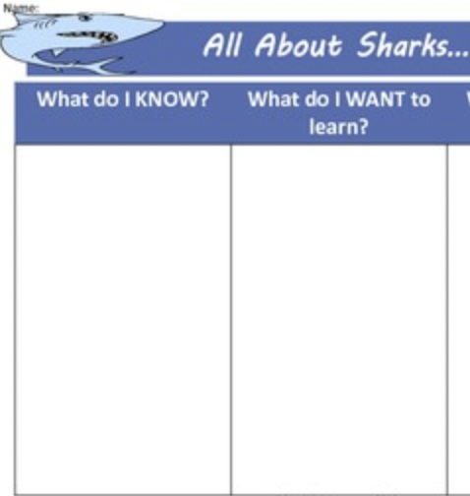
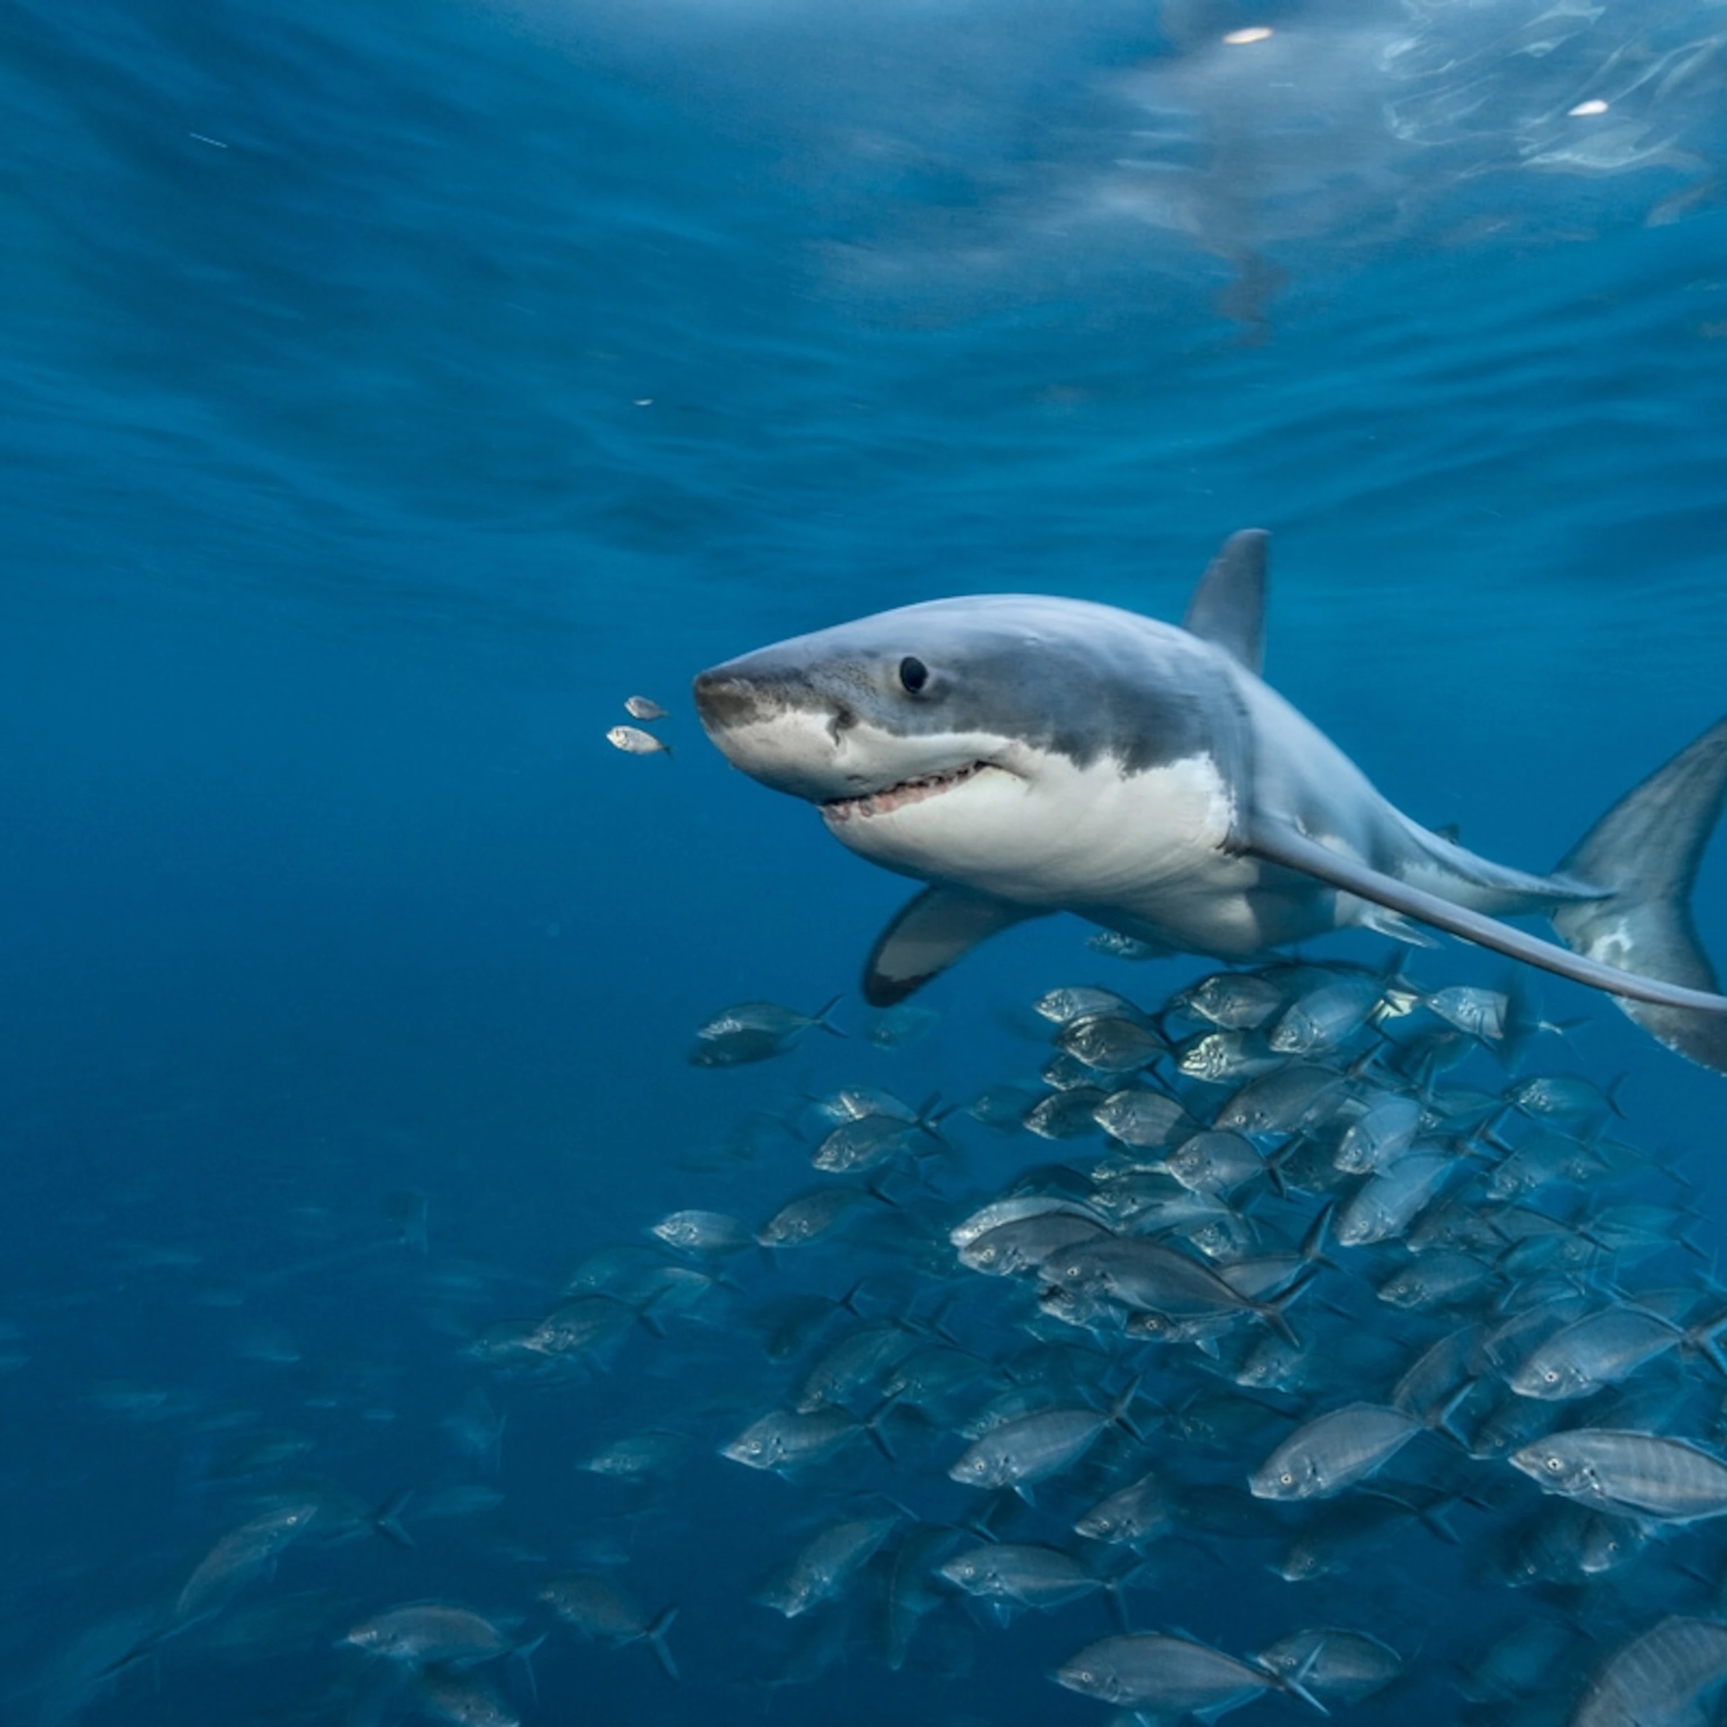
Know & Wonder
‘Pass the paper’ activity
Group work
K & L in two different columns
Share anything you know about sharks with your peers.
List questions that you’d like to ask about sharks
Pass the paper every two minutes
Report back to the whole class

Slide 14
Know: Sharks
have very sharp teeth
a type of fish
live in the ocean
are good swimmers
are dangerous
attack people
…

Slide 15
Wonder: Sharks
Do they also live in rivers?
Are there different types of sharks?
How long have they been living on the earth?
How big/heavy are they?
What’s sharks’ favourite food?
How fast can they swim?
How dangerous are they?
How many teeth do they have?
…
We can also encourage SS to creatively answer those questions they have listed.

Slide 16
Sharks: check your K and find answers to your W
Sharks are astonishing fish that have been on Earth as long as the dinosaurs. Sharks live in water all around the world. They live in oceans, and sometimes you can even find them in rivers and lakes. Sharks live mainly in warm water. Some sharks live near the surface of the ocean, and some live in deep water. Many sharks travel across the ocean and some live in the same area their entire lives.
There are many different types of sharks. Some sharks are as small as a person’s hand, and some sharks are as large as a bus. Most sharks are in the middle and are about the same size as humans, 5 – 7 feet long.
Sharks have no bones. Their skeleton is made of cartilage. Cartilage is a strong fibrous substance. Cartilage is softer than bone. Our ears and noses are made of cartilage.
Sharks can only swim forward. They can have up to 3,000 teeth at one time. Their teeth are arranged in rows. Sharks have about 5 rows of teeth. If a tooth is lost or damaged, they replace it with another. Most of the time, sharks do not chew their food. They swallow their food whole.
All sharks are carnivores. They are meat eaters. Sharks have a wide variety of diets. Some sharks eat fish, squid, other sharks, and marine animals. Other sharks eat crabs, clams, plankton, and shellfish.
Sharks breathe underwater with gills. A gill is an organ that is located on the shark’s side The gills take in oxygen from the water. There are 5 to 7 gill slits on a shark.
There are over 350 different species of sharks. Sharks are amazing animals that are at the top of the marine food chain.

Slide 17
While-reading: teach ss to make sense of the unknown words in context
Sharks are astonishing fish that have been on Earth as long as the dinosaurs. Sharks live in water all around the world. They live in oceans, and sometimes you can even find them in rivers and lakes. Sharks live mainly in warm water. Some sharks live near the surface of the ocean, and some live in deep water. Many sharks travel across the ocean and some live in the same area their entire lives.
There are many different types of sharks. Some sharks are as small as a person’s hand, and some sharks are as large as a bus. Most sharks are in the middle and are about the same size as humans, 5 – 7 feet long.
Sharks have no bones. Their skeleton is made of cartilage. Cartilage is a strong fibrous substance. Cartilage is softer than bone. Our ears and noses are made of cartilage.
Sharks can only swim forward. They can have up to 3,000 teeth at one time. Their teeth are arranged in rows. Sharks have about 5 rows of teeth. If a tooth is lost or damaged, they replace it with another. Most of the time, sharks do not chew their food. They swallow their food whole.
All sharks are carnivores. They are meat eaters. Sharks have a wide variety of diets. Some sharks eat fish, squid, other sharks, and marine animals. Other sharks eat crabs, clams, plankton, and shellfish.
Sharks breathe underwater with gills. A gill is an organ that is located on the shark’s side The gills take in oxygen from the water. There are 5 to 7 gill slits on a shark.
There are over 350 different species of sharks. Sharks are amazing animals that are at the top of the marine food chain.

Slide 18
What post-reading activities can we do?
Apart from answering questions (including open-ended questions and multiple-choice questions, true or false statements, what other activities can we do to help ss really take in their reading)
Please share your brilliant practice in the chat box!

Slide 19
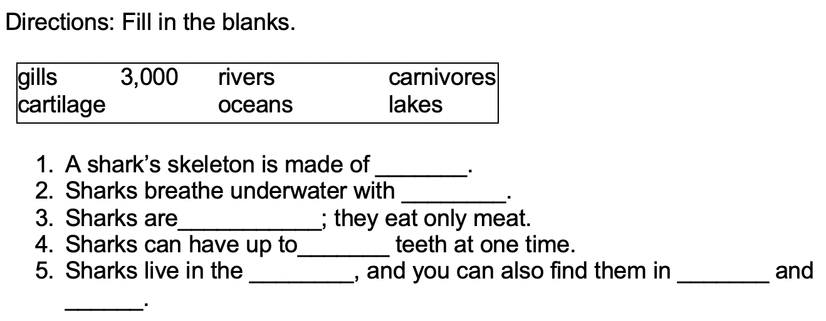
Post-reading activities that we can use
1.
2. Scrambles: unscramble the words related to sharks
Word level
1. s i g l l___________
2. a c g e r i a I t___________
3. n o c a e ____________

Slide 20
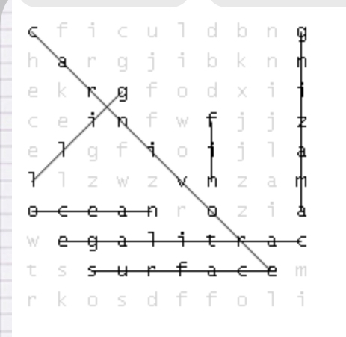
Post-reading activities that we can use
Vocab
3. word puzzles
https://puzzlemaker.discoveryeducation.com/word-search

Slide 21
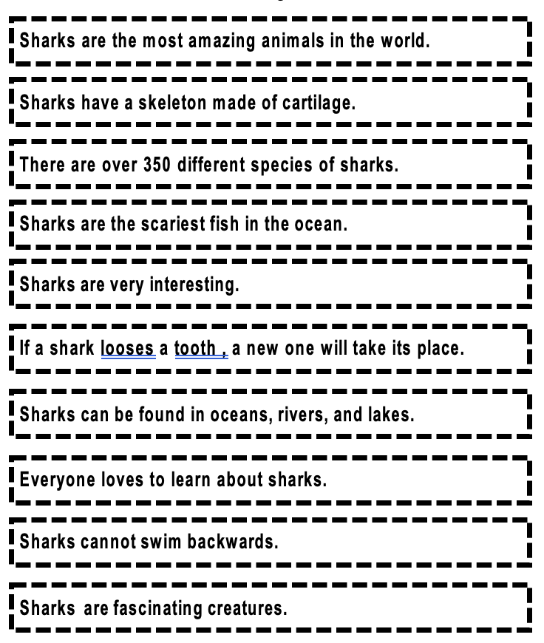
Post-reading activities that we can use
Facts/Opinions
Cut out each sentence strip. Read each sentence, and put each sentence under the correct heading.

Slide 22
Post-reading activities: discourse level
1. Find the right topic sentence for each paragraph (can differentiate this by giving more topic sentences than needed)
____________________ Their skeleton is made of cartilage. Cartilage is a strong fibrous substance. Cartilage is softer than bone. Our ears and noses are made of cartilage.
______________________________A gill is an organ that is located on the shark’s side The gills take in oxygen from the water. There are 5 to 7 gill slits on a shark.
Sharks breathe underwater with gills.
Sharks have no bones.
Sharks have soft bones.
2. Give only the topic sentence and ask SS to expand it with supporting evidence. (can provide a list of support sentences.)
All sharks are carnivores.
__________________________________
__________________________________
__________________________________
They have a wide variety of diets including fish, squid, other sharks.
They eat only meat nothing else.
Sharks have no bone.
They are meat eaters. Sharks have a wide variety of diets. Some sharks eat fish, squid, other sharks, and marine animals. Other sharks eat crabs, clams, plankton, and shellfish.
Sharks breathe underwater with gills.

Slide 23
Post-reading activities: discourse level
1. Cloze (memory challenge)
Sharks have no bones. Their skeleton is made of cartilage. Cartilage is a strong fibrous substance. Cartilage is softer than bone. Our ears and noses are made of cartilage.
2. Give only the topic sentence, and ask SS to expand it with supporting evidence. (can provide a list of support sentences.)
All sharks are carnivores.
They are meat eaters. Sharks have a wide variety of diets. Some sharks eat fish, squid, other sharks, and marine animals. Other sharks eat crabs, clams, plankton, and shellfish.
They have a wide variety of diets including fish, squid, other sharks.
They eat only meat nothing else.

Slide 24
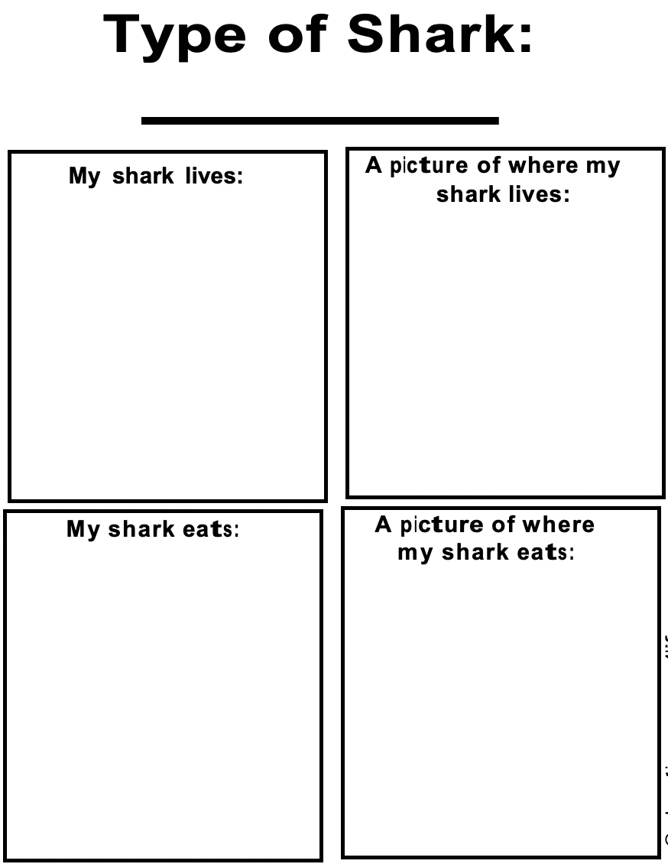
3. Design a poster
Collect a few extra pieces of reading on the same topic and assign them to different groups or pairs and ask them to create a poster and share with the whole class
(Select readings that can be related to some of those questions they have asked in the W section) Or ask SS to find out answers to the questions they particularly like.

Slide 25
Learned: what have you learnt about sharks?
Pass the paper activity again
Carnivores
Live in oceans, rivers and lakes
Have different sizes
Have up to 3000 teeth
Can only swim forward
Some are as big as a bus.
They have no bones.
…

Slide 26
KWL Chart Put it all together

Slide 27
Reflection & analysis
What is the structure/framework/chart I have used today to show teaching?
Why does KWL matter? Why is it helpful to structure reading?
K: connection (personal, meaningful, schema, co-construct knowledge: PTP)
W: voice and learning beyond class
L: makes learning tangible with evidence (exit ticket)
Teaching reading is not just for the sake of reading (G+V). Teachers should create opportunities that enable students to actively interact with the text as well as their peers.
Create meaningful exercises for better word retention.
Less on grammar and sentence by sentence analysis but more on empowering them to work the meaning out, to understand how reading can be constructed or deconstructed. (revisit the same reading and each time with a different focus)

Slide 28
Your KWL Exit ticket

Slide 29
Thank you for listening!
Any questions?
Bye for now!

